Slide 1

The Cortana Intelligence Suite
TDSP for DevOps
Microsoft Research and AI
Learnanalytics.microsoft.com
Notes:
Description:
DevOps (Developer Operations) is defined as a development process that emphasizes communication and collaboration between product management, software development, and operations, automating the process of solution integration, testing, deployment and infrastructure changes.
All projects involving on-premises software and hardware benefits from DevOps. But hybrid and cloud-only architectures require it – there are so many variables to even setting up the architecture that a dedicated team or developer is often required. And Advanced Analytics projects involving Data Science have even more requirements that are specific to these tasks.
This course explains the processes, procedures, platform options that you have available, along with explaining the tools you need to use to create an effective DevOps solution for your Advanced Analytics projects.
Level:
300
Audience:
Technical professionals tasked with the infrastructure and development of a DevOps practice for Advanced Analytics Projects.

Slide 2
Welcome!

Slide 3



Lab:
Optional: Local Workstation Setup
Notes:
Optional, if using your local Windows machine (the Data Science Virtual Machine located in later labs already has these items installed):
Install Visual Studio Code – https://code.visualstudio.com/
Add the Visual Studio Team Services extension - https://marketplace.visualstudio.com/items?itemName=ms-vsts.team
Install Power BI Desktop - https://powerbi.microsoft.com/en-us/desktop/
Install the Azure SDK - https://www.visualstudio.com/downloads/
Install Azure PowerShell - https://www.microsoft.com/web/handlers/webpi.ashx/getinstaller/WindowsAzurePowershellGet.3f.3f.3fnew.appids
Install Azure CLI - https://docs.microsoft.com/en-us/cli/azure/install-azure-cli

Slide 4
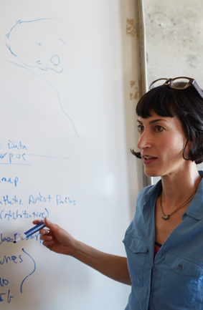
Learning Objectives
Plan for an Advanced Analytics solution using a prescribed process
Understand platform component options
Understand and implement Developer Operations (DevOps) processes and Functions
Understand and implement the tools required for setting up, managing, coding and delivering a Data Science project
Notes:
Course Objectives - At the end of this Module, you will:
Plan for an Advanced Analytics solution using a prescribed process
Understand platform component options
Understand and implement Developer Operations (DevOps) processes and Functions
Understand and implement the tools required for setting up, managing, coding and delivering a Data Science project

Slide 5
Advanced Analytics
Notes:
In order to understand DevOps on Advanced Analytics, we need to understand that AA combines multiple disciplines - https://www.microsoft.com/en-us/cloud-platform/advanced-analytics

Slide 6
The Need for DevOps and Data Science
Monitor
Code
Test
Package
Deploy
Build
Configure
Use
AI / ML / DL
Notes:
The first thing to know is that organizations do not always consider a “Data Science” or AI project as a separate entity – they view it as a continuum in their data-as-asset strategy.
SQL Server - https://www.microsoft.com/en-us/sql-server/default.aspx
Reporting Services - https://docs.microsoft.com/en-us/sql/reporting-services/create-deploy-and-manage-mobile-and-paginated-reports
Writing T-SQL Statements - https://docs.microsoft.com/en-us/sql/t-sql/tutorial-writing-transact-sql-statements
SQL Server and Azure Analysis Services - https://docs.microsoft.com/en-us/azure/analysis-services/analysis-services-overview
Data Science Track - https://academy.microsoft.com/en-us/professional-program/data-science/
Microsoft Machine Learning - https://azure.microsoft.com/en-us/services/machine-learning/
Artificial Intelligence and Cognitive Services at Microsoft - https://www.microsoft.com/en-us/ai
Microsoft Deep Learning - https://www.microsoft.com/en-us/research/group/deep-learning-group/

Slide 7
The Team Data Science Process
Business Understanding
Define Objectives
Identify Data Sources
Data Acquisition and Understanding
Ingest Data
Explore Data
Modeling
Feature Selection
Create and Train Model
Deployment
Customer Acceptance
Operationalize
Testing and Validation
Update Data
Handoff
Re-train and re-score
http://aka.ms/tdsp
Notes:
It also references the Cortana Intelligence process - https://azure.microsoft.com/en-us/documentation/articles/data-science-process-overview/
A complete process diagram is here - https://azure.microsoft.com/en-us/documentation/learning-paths/cortana-analytics-process/
Some walk-throughs of the various services - https://azure.microsoft.com/en-us/documentation/articles/data-science-process-walkthroughs/
An integrated process and toolset allows for a more close-to-intent deployment
Iterations are required to close in on the solution – but are harder to manage and monitor
Data Science Blog - https://buckwoody.wordpress.com/

Slide 8
The Azure Platform For Analytics and AI
Big Data
Intelligence and Advanced Analytics
Information Management
Solutions
Visualization
Data Catalog
Data Factory
Event Hubs
Data Lake
SQL Data Warehouse
Cosmos DB
Cortana, Bot Service, Cognitive Framework
HDInsight
Data Lake
Azure Storage
Stream Analytics
Analysis Services
Power BI
R
Templates and Gallery
Machine Learning
Notes:
Azure Data Catalog - http://azure.microsoft.com/en-us/services/data-catalog (Doc It)
Azure Data Factory - http://azure.microsoft.com/en-us/services/data-factory/ (Move It)
Azure Event Hubs - http://azure.microsoft.com/en-us/services/event-hubs/ (Bring It)
Platform and Storage - Microsoft Azure – http://microsoftazure.com Storage - https://azure.microsoft.com/en-us/documentation/services/storage/ (Host It)
Azure Data Lake - http://azure.microsoft.com/en-us/campaigns/data-lake/ (Store It)
Azure SQL Data Warehouse - http://azure.microsoft.com/en-us/services/sql-data-warehouse/ (Relate It)
Azure Cosmos DB - https://docs.microsoft.com/en-us/azure/cosmos-db/introduction
Cortana - http://blogs.windows.com/buildingapps/2014/09/23/cortana-integration-and-speech-recognition-new-code-samples/ and https://blogs.windows.com/buildingapps/2015/08/25/using-cortana-to-interact-with-your-customers-10-by-10/ and https://developer.microsoft.com/en-us/Cortana (Say It)
Cognitive Services - https://www.microsoft.com/cognitive-services
Bot Framework - https://dev.botframework.com/
Azure Machine Learning - http://azure.microsoft.com/en-us/services/machine-learning/ (Learn It)
Azure HDInsight - http://azure.microsoft.com/en-us/services/hdinsight/ (Scale It)
Azure Stream Analytics - http://azure.microsoft.com/en-us/services/stream-analytics/ (Stream It)
Analysis Services - https://docs.microsoft.com/en-us/azure/analysis-services/analysis-services-overview
Power BI - https://powerbi.microsoft.com/ (See It)
All of the components within the suite - https://www.microsoft.com/en-us/server-cloud/cortana-intelligence-suite/what-is-cortana-intelligence.aspx
Templates - https://gallery.cortanaintelligence.com/browse?orderby=freshness%20desc&skip=0&categories=%5B%2210%22%5D and https://caqs.azure.net/#gallery

Slide 9
DevOps
Notes:
Complete DevOps guide - https://docsmsftpdfs.blob.core.windows.net/guides/azure/azure-ops-guide.pdf
Azure Design Patterns: https://blogs.msdn.microsoft.com/uk_faculty_connection/2017/05/17/getting-started-with-azure-design-patterns-and-azure-arm-quick-start-templates/
Deployment
Service Creation and Setup - https://azure.microsoft.com/en-us/offers/ms-azr-0003p/
Cost Management (Pricing) - https://azure.microsoft.com/en-us/pricing/
Migrations - https://msdn.microsoft.com/en-us/library/dn727097.aspx
Tools
The Azure Portal - https://docs.microsoft.com/en-us/azure/azure-portal-overview
PowerShell - https://docs.microsoft.com/en-us/powershell/azure/overview?view=azurermps-3.8.0
CLI - https://docs.microsoft.com/en-us/cli/azure/install-azure-cli
Others - Visual Studio, System Center, Jenkins, chef
Azure Automation - https://azure.microsoft.com/en-us/services/automation/
Facilities and Regions
Locations - https://azure.microsoft.com/en-us/regions/
Security
Authentication and Access - https://docs.microsoft.com/en-us/azure/active-directory/connect/active-directory-aadconnect
Security best practices - https://docs.microsoft.com/en-us/azure/active-directory/role-based-access-control-configure
Azure Trust Center - https://azure.microsoft.com/en-us/support/trust-center/
Resource Grouping
Resource Groups - https://docs.microsoft.com/en-us/azure/azure-resource-manager/resource-group-overview
Using the ARM model - https://docs.microsoft.com/en-us/azure/azure-resource-manager/resource-group-template-deploy-portal
Safety - https://docs.microsoft.com/en-us/azure/storage/storage-redundancy
Auditing - https://msdn.microsoft.com/en-us/library/mt662411.aspx?f=255&MSPPError=-2147217396
Troubleshooting and Support - https://azure.microsoft.com/en-us/blog/understanding-azure-troubleshooting-and-support/
Top 10 resources to keep up to date with the Azure Platform - https://blogs.msdn.microsoft.com/bizspark_au/2017/07/07/top-10-resources-i-use-to-keep-up-to-date-with-new-innovations-on-the-azure-platform/
Special considerations for Advanced Analytics:
Account management
Storage and redundancy
Privacy and data protection
Scheduling and Pipelined workflows
Networking - https://www.simple-talk.com/cloud/cloud-data/azure-networking-sql-server-dbas/
Optimization
Security
Advanced Analytics Services awareness – data transfer, storage and processing
Dependencies and interactions

Slide 10

DevOps <> Toolchain
Microsoft Project, Flow
PowerPoint/ Visio, Azure Gallery
ARM, PowerShell, CLI
Dev Environments – DSVM or Containers
Visual Studio
Azure Data Catalog
Visual Studio Team Services, Team Foundation Server
System Center
Visual Studio Online, Team Foundation Server
Visual Studio
DVSM
Azure Portal
Azure ML Studio
Visual Studio Team Services
Visual Studio
System Center
Visual Studio Team Services
System Center
Threat Monitoring Tool
Attack Surface Analyzer
Visual Studio Team Services
System Center
Azure Data Factory
ARM and DSC
Visual Studio Team Services
System Center
Azure Deployment
Application Insights
System Center
Azure Data Factory
Log Scrubbing
DevOps Process Focus
Configure
Build
Monitor
Code
Test
Package
Release
Notes:
Companies have two buckets of software they write or adapt – systems of operation, and systems of engagement
Most DevOps focused materials deal with the “Toolchain” – the tools drive the process. This isn’t actually optimal.
Learning Path for DevOps and Advanced Analytics - https://github.com/BuckWoody/LearningPaths/blob/master/IT%20Architect/Learning%20Path%20-%20Devops%20for%20Data%20Science.md
Parts Unlimited MRP, a sample DevOps environment - https://microsoft.github.io/PartsUnlimitedMRP/

Slide 11






DevOps: the three stage conversation
DEV
OPS
1
People
2
Process
3
Products
Notes:
Information Technology Infrastructure Library - http://www.itinfo.am/eng/information-technology-infrastructure-library-guide/
“Shift-Left” - https://devops.com/devops-shift-left-avoid-failure/
“DevOps is the union of People, Process, and Products to continuously deliver value to users” – but primarily about the culture. While not everyone on the team needs to know everything in depth, it’s important to share across disciplines, such as security and account management.
People = Culture
Everyone should be unified from business requirements to delivery of software to end users.
Fundamental attributes of successful cultures:
Shared mission and incentives: infrastructure as code, apps as services, DevOps/all as teams
You need to consider your hardware as a commodity, (don't give your servers names) , servers are like farm animals, it is just harder if you let theids name them
Build deep instrumentation into services, push complexity up the stack
Rally around agile, shared metrics, CI, service owners on call, etc.
Changing the culture: any change takes time, changing culture is no exception and you can't do it alone, exploit compelling events to change culture: downtimes, cloud adoption, devops buzz
PROCESS Definition and design, compliance, and continuous improvement, LEAN
Products Automation requires Tools/Products to eliminate waste

Slide 12
DevOps Maturity
Monitor
Configure
Code
Build
Test
Package
Deploy
Infrastructure as Code (IaC)
Continuous Integration
Automated Testing
Continuous Deployment
Release Management
App Performance Monitoring
Load Testing & Auto-Scale
http://www.itproguy.com/devops-practices/
Notes:
Microsoft DevOps site - https://www.microsoft.com/en-us/cloud-platform/development-operations

Slide 13
DevOps Focus for Advanced Analytics
Communication/Culture
Accounts and Plumbing
Shared Development
Data Flow – In and Out
Builds and Tests
Security
Notes:
Start with a view of the project to start the discussion - https://buckwoody.wordpress.com/2017/08/17/a-data-science-microsoft-project-template-you-can-use-in-your-solutions/
Account management is something that will often be new to the Data Science Team – https://docs.microsoft.com/en-us/azure/billing/billing-getting-started
Setting up the Azure Environment, particularly working with the Azure Resource Model and deployment slots, is important to consider at the outset – https://azure.microsoft.com/en-us/resources/videos/resource-group-model-modern-management-for-modern-cloud/
Development should break out of silos, so DevOps CI/CT/CD should be integrated early – https://docs.microsoft.com/en-us/aspnet/aspnet/overview/developing-apps-with-windows-azure/building-real-world-cloud-apps-with-windows-azure/continuous-integration-and-continuous-delivery
It’s important to consider the end-to-end experience, as this affects everything from security to design – https://gallery.cortanaintelligence.com/Tutorial/Create-an-End-to-End-E2E-Deployment-ready-Data-Pipeline-for-Consuming-Azure-Services-A-Step-by-Step-Guide-2
There is often an established Build/Test environment in the organization that may include CI/CT/CD – these need to be considered early (shift-left) – https://msdn.microsoft.com/en-us/library/dn449957.aspx
Data is important, and a full scrub for PII and other sensitivities are very important to the Data Science project - https://msdn.microsoft.com/en-us/magazine/ee291586.aspx

Slide 14
The Data Science/DevOps Difference
Communication
Business Understanding
Define Objectives
Identify Data Sources
Data Acquisition and Understanding
Ingest Data
Explore Data
Modeling
Feature Selection
Create and Train Model
Deployment
Customer Acceptance
Operationalize
Testing and Validation
Update Data
Handoff
Re-train and re-score
Notes:
Working in a team means “shifting left” – a new concept for many technologists - https://www.cio.com/article/3050579/leadership-management/want-agile-devops-shift-left.html

Slide 15
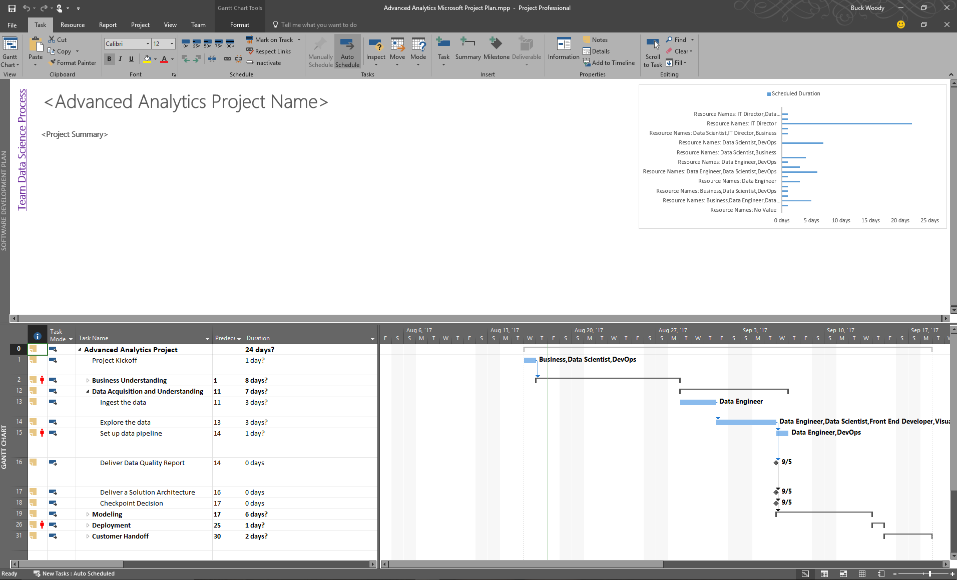
The Data Science/DevOps Difference - Communication
Participating in a Project Framework
Notes:
Working with Microsoft Project in Solutions: https://buckwoody.wordpress.com/2017/08/17/a-data-science-microsoft-project-template-you-can-use-in-your-solutions/
Synchronizing your TFS with MPS - https://www.visualstudio.com/en-us/docs/work/office/sync-ps-tfs

Slide 16
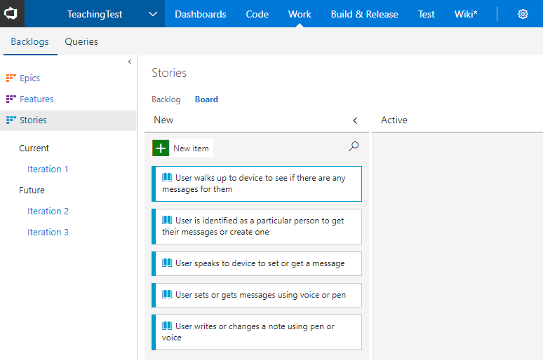
The Data Science/DevOps Difference – Communication
Devs – Stories and Features
Notes:
Analyze and Model your architecture in Visual Studio - https://msdn.microsoft.com/library/57b85fsc%28v=vs.140%29.aspx
Video – capture business workflows - http://channel9.msdn.com/posts/clinted/uml-with-vs-2010-part-4-capture-business-workflows/
Video – Improve architecture through modeling - http://go.microsoft.com/fwlink/?LinkID=252078
Creating your backlog - https://www.visualstudio.com/en-us/docs/work/backlogs/create-your-backlog

Slide 17


Data Science – Problem to Data Flow
The Data Science/DevOps Difference - Communication
Determine the Question
Document the Data
Diagram the Data Flow
Notes:
PowerPoint, Visio, Whiteboard – choose a visualization declaration mechanism, make it part of your check in. Make sure you treat infrastructure and code as a single thought-entity. - https://www.visualstudio.com/en-us/docs/work/office/storyboard-your-ideas-using-powerpoint
Using a holistic approach: https://www.linkedin.com/pulse/architecture-data-exploration-using-microsoft-azure-verdon-mba
Planning a Big Data solution: https://msdn.microsoft.com/en-us/library/dn749858.aspx

Slide 18
The Data Science/DevOps Difference - Communication
Business Case
Wide World Importers is a company that imports and distributes products in multiple countries around the globe.
With several thousand employees, Information Technology is at the heart of our business operations, and has a significant cost.
Since we handle materials in multiple countries, we have a lot of private data, financial information, and other targets which have a high security profile. We are concerned with both external and internal attacks. In addition, many of our employees work in remote locations, some on ships and other challenging environments.
All of our IT systems have been modernized, and we’re taking in a significant amount of semi-structured data from computing devices – most of it real-time. After talking with our IT leadership, we need a way to determine anomalies within the data streams we get, and have a way to observe the anomalies in a dashboard so that we can respond to outages, threats, and changes quickly.
Notes:
More about Wide World Importers: https://docs.microsoft.com/en-us/sql/sample/world-wide-importers/overview
Anomaly Detection: https://gallery.cortanaintelligence.com/Solution/Anomaly-Detection-in-Real-time-Data-Streams

Slide 19
The Data Science/DevOps Difference - Communication
Design Statements
Wide World Importers is a company that imports and distributes products in multiple countries around the globe.
With several thousand employees, Information Technology is at the heart of our business operations, and has a significant cost.
Since we handle materials in multiple countries, we have a lot of private data, financial information, and other targets which have a high security profile. We are concerned with both external and internal attacks. In addition, many of our employees work in remote locations, some on ships and other challenging environments.
All of our IT systems have been modernized, and we’re taking in a significant amount of semi-structured data from computing devices – most of it real-time. After talking with our IT leadership, we need a way to determine anomalies within the data streams we get, and have a way to observe the anomalies in a dashboard so that we can respond to outages, threats, and changes quickly.
Notes:
More about Wide World Importers: https://docs.microsoft.com/en-us/sql/sample/world-wide-importers/overview
Anomaly Detection: https://gallery.cortanaintelligence.com/Solution/Anomaly-Detection-in-Real-time-Data-Streams

Slide 20
The Data Science/DevOps Difference - Communication
Decision Matrix
Decision | Technology | Elements | Rationale
Large amounts of semi-structured data | Azure Tables | Scale, KVP, Multi-access | Can be used by multiple technologies or queried
Fast, multiple sources of data | Event Hubs, Stream Analytics | Speed, complex processing | Fast Ingestion of massive datasets
Anomaly detection | Azure ML | API-Driven detection | Built-in algorithms, multi-dev
Reporting | SQL DB, Power BI | Ease of reporting, data visualization | Standard queries, action-based visualizations
System monitoring and management | Azure Data Factory, Application Insights | Actionable system metrics | OOB orchestration and reporting
Notes:
Another approach on decision matrices: http://www.businessnewsdaily.com/6146-decision-matrix.html

Slide 21
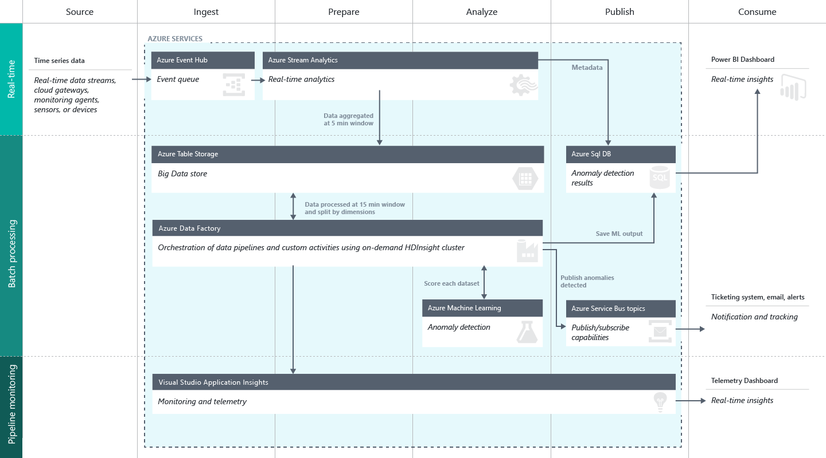
The Data Science/DevOps Difference - Communication
Create a Data Flow
Notes:
Full description is here: https://github.com/Azure/itanomalyinsights-cortana-intelligence-preconfigured-solution/blob/master/Docs/IT%20Anomaly%20Insights%20Post%20Deployment%20Instructions.md
Create your own Solution Templates: https://start.cortanaintelligence.com/CustomSolutions
More solution tutorials: https://gallery.cortanaintelligence.com/browse?categories=%5B%227%22%5D&skip=0&orderby=trending%20desc&tags=%5B%22Solution%22%5D
https://microsoft.github.io/techcasestudies/#sortBy=featured&SearchPhraseText=devops
https://microsoft.github.io/techcasestudies/#sortBy=featured&SearchPhraseText=vsm

Slide 22
Document the Data - Azure Data Catalog
Register data sources
Tag the data
Document the data
Search and connect
Notes:
Full example: https://azure.microsoft.com/en-us/documentation/articles/data-catalog-get-started/

Slide 23
Lab:
Create Solution Design Questions
Notes:
Open this page - https://technet.microsoft.com/en-us/library/ms124825(v=sql.100).aspx
Read the company description you find
The company wants to add in some production optimizations. What are some of the questions Data Science could answer for them, given their data? - https://docs.microsoft.com/en-us/azure/machine-learning/machine-learning-data-science-for-beginners-the-5-questions-data-science-answers

Slide 24
The Data Science/DevOps Difference
Accounts and Plumbing
Business Understanding
Define Objectives
Identify Data Sources
Data Acquisition and Understanding
Ingest Data
Explore Data
Modeling
Feature Selection
Create and Train Model
Deployment
Customer Acceptance
Operationalize
Testing and Validation
Update Data
Handoff
Re-train and re-score
Notes:
Microsoft Azure Essentials, the best place to get started with and learn more about Azure - https://www.microsoft.com/en-us/azureessentials
Understanding the Azure Portal for management and billing - https://azure.microsoft.com/en-us/account/

Slide 25
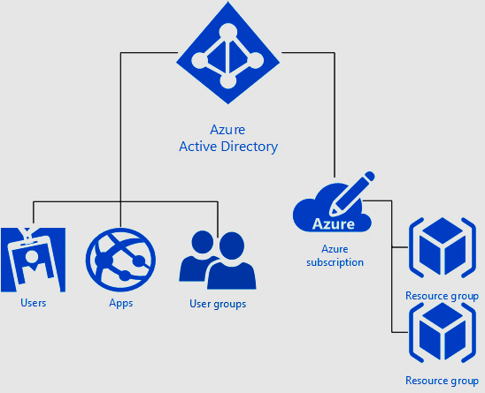
The Data Science/DevOps Difference – Accounts and Plumbing
Accounts and Groups in Microsoft Azure
Notes:
Understanding the security waterfall - https://docs.microsoft.com/en-us/azure/active-directory/active-directory-understanding-resource-access
Main Portal Documentation - https://docs.microsoft.com/en-us/azure/azure-portal-overview
Role-Based Access control - https://docs.microsoft.com/en-us/azure/active-directory/role-based-access-control-what-is
DevOps with the Azure Portal - https://docs.microsoft.com/en-us/azure/azure-portal/tutorial-azureportal-devops

Slide 26
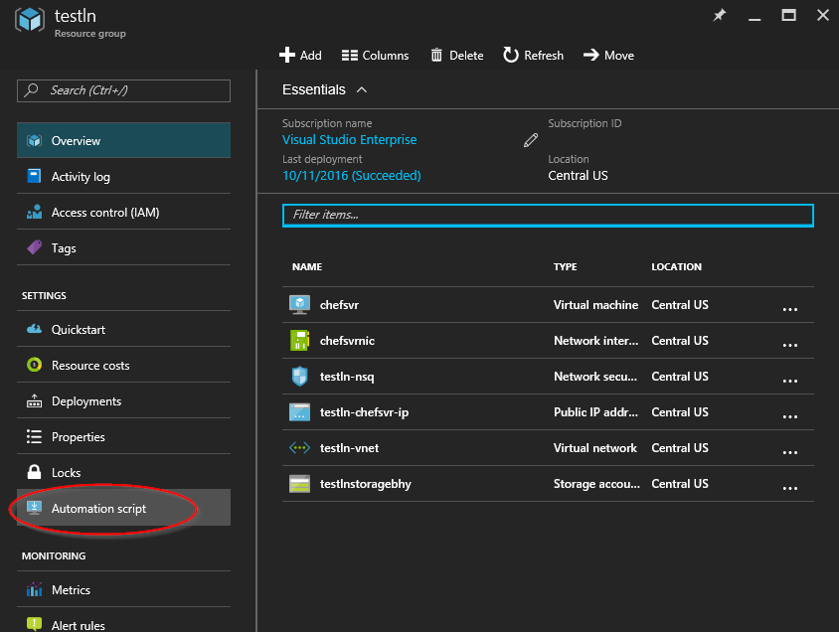
The Data Science/DevOps Difference – Accounts and Plumbing
The Azure Resource Model
Notes:
Understanding the Azure Resource Model - https://docs.microsoft.com/en-us/azure/azure-resource-manager/resource-group-overview
Deploying resources with ARM Templates - https://docs.microsoft.com/en-us/azure/azure-resource-manager/resource-group-template-deploy
Create flexible ARM templates using conditions and logical functions - https://azure.microsoft.com/en-us/blog/create-flexible-arm-templates-using-conditions-and-logical-functions/
More on the DSC - http://channel9.msdn.com/Events/Ignite/2015/BRK3467

Slide 27
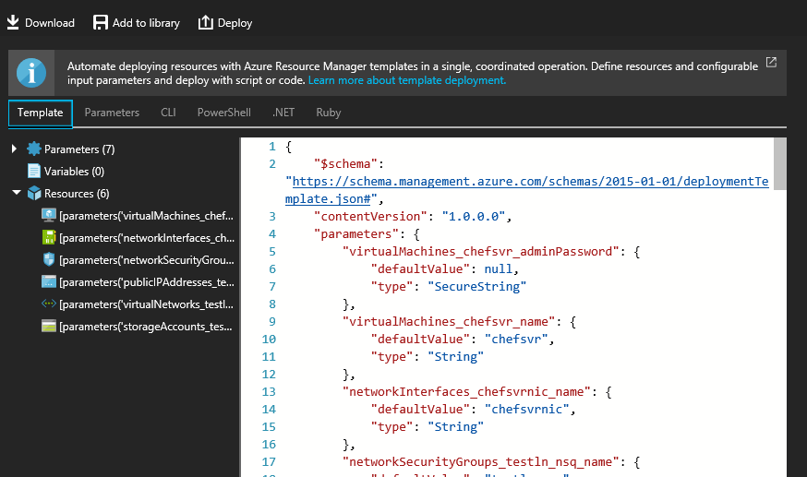
The Data Science/DevOps Difference – Accounts and Plumbing
PowerShell and the CLI
Notes:
Getting Started with Microsoft Azure PowerShell - https://blogs.msdn.microsoft.com/mvpawardprogram/2017/08/22/microsoft-azure-powershell/

Slide 28
Lab:
Export Infrastructure as Code with the Azure Resource Model
Notes:
Open Visual Studio Locally (Note: you must have the Azure SDK installed) or on the Data Science Virtual Machine (Already contains the Azure SDK)
Open this reference, and follow the instructions you see there - https://docs.microsoft.com/en-us/azure/azure-resource-manager/vs-azure-tools-resource-groups-deployment-projects-create-deploy

Slide 29
The Data Science/DevOps Difference
Shared Development
Business Understanding
Define Objectives
Identify Data Sources
Data Acquisition and Understanding
Ingest Data
Explore Data
Modeling
Feature Selection
Create and Train Model
Deployment
Customer Acceptance
Operationalize
Testing and Validation
Update Data
Handoff
Re-train and re-score
Notes:
Working effectively in teams - https://www.svds.com/working-effectively-in-data-science-teams/

Slide 30
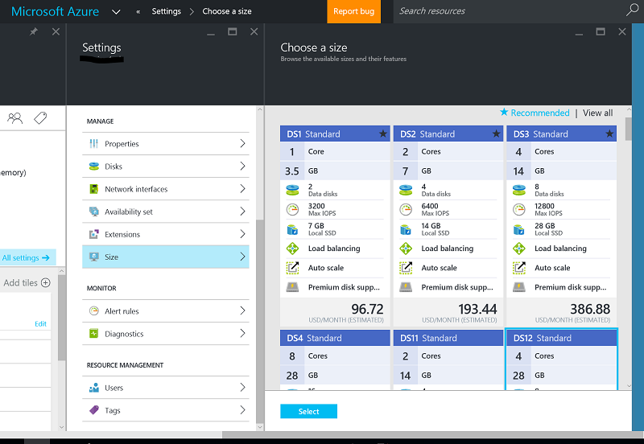
The Data Science/DevOps Difference – Shared Development
Development Environments
The Data Science Virtual Machine
Azure Containers
Notes:
Introduction to the DSVM - https://docs.microsoft.com/en-us/azure/machine-learning/machine-learning-data-science-virtual-machine-overview
Set up data science environments for use in the Team Data Science Process - https://docs.microsoft.com/en-us/azure/machine-learning/machine-learning-data-science-environment-setup
Working with Kubernetes or Docker Swarms: https://docs.microsoft.com/en-us/azure/container-service/
Create a CI/CD pipeline for containerized ASP.NET Core projects - https://blogs.msdn.microsoft.com/visualstudio/2017/08/22/create-a-cicd-pipeline-for-containerized-asp-net-core-projects/
Book on Azure Containers - https://blogs.msdn.microsoft.com/microsoft_press/2017/08/30/free-ebook-introduction-to-windows-containers/

Slide 31
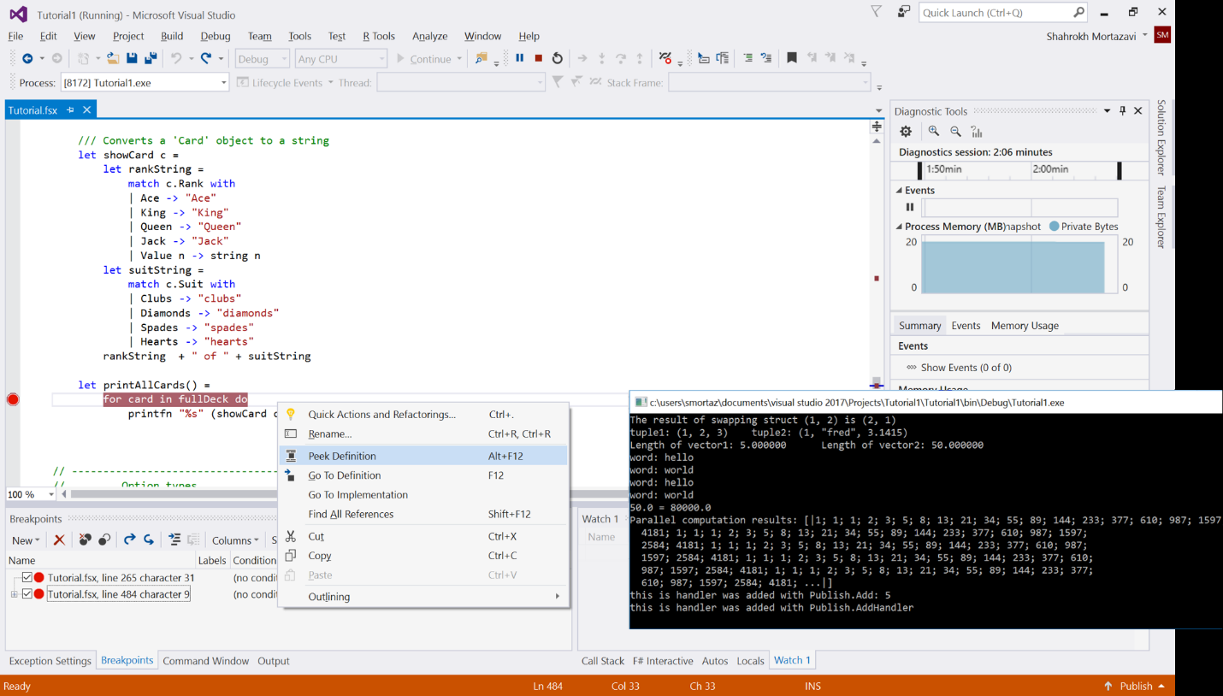
The Data Science/DevOps Difference – Accounts and Plumbing
Visual Studio with VSTS / VS and VS Code
R Tools for Visual Studio
Python Tools for Visual Studio
Azure Data Lake and Stream Analytics tools for Visual Studio (U-SQL Local Editor and Run)
Cosmos DB with Visual Studio
The Data Science Workload for VS2017
PowerShell tools for Visual Studio
Cloud Explorer for Visual
Azure Storage Add-in
HDInsight Tools for Visual Studio
Azure Data Factory with Visual Studio
SQL Data Warehouse with Visual Studio
Azure Analysis Services with Visual Studio
Notes:
Create a free account - https://go.microsoft.com/fwlink/?LinkId=307137&clcid=0x409
Head Documentation Page - https://www.visualstudio.com/en-us/docs/overview
DevOps references - https://www.visualstudio.com/en-us/docs/setup-admin/get-started
An end-to-end example of ci/cd: https://blogs.msdn.microsoft.com/uk_faculty_connection/2015/09/07/continuous-integration-and-testing-using-visual-studio-online/
An hour-long video of using Visual Studio and Visual Studio Online to move through an Agile workflow - https://tv.ssw.com/5642/project-management-with-visual-studio-online-dev-superpowers-episode-5
R Tools for Visual Studio – https://docs.microsoft.com/en-us/visualstudio/rtvs/
Python Tools for Visual Studio – https://docs.microsoft.com/en-us/visualstudio/python/python-in-visual-studio
Visual Studio 2017 - https://blogs.msdn.microsoft.com/visualstudio/2016/11/18/data-science-workloads-in-visual-studio-2017-rc/
PowerShell tools for Visual Studio - https://github.com/adamdriscoll/poshtools
Cloud Explorer for Visual Studio - https://docs.microsoft.com/en-us/azure/vs-azure-tools-resources-managing-with-cloud-explorer
Storage Tool Clients, including Visual Studio - https://docs.microsoft.com/en-us/azure/storage/common/storage-explorers
HDInsight Tools for Visual Studio - https://docs.microsoft.com/en-us/azure/hdinsight/hdinsight-hadoop-visual-studio-tools-get-started
Azure Data Lake and Stream Analytics tools for Visual Studio – https://www.microsoft.com/en-us/download/details.aspx?id=49504
U-SQL Local Editor and Run - https://channel9.msdn.com/series/azuredatalake/usql-localrun
Azure Data Factory with Visual Studio - https://docs.microsoft.com/en-us/azure/data-factory/data-factory-build-your-first-pipeline-using-vs
SQL Data Warehouse with Visual Studio - https://docs.microsoft.com/en-us/azure/sql-data-warehouse/sql-data-warehouse-query-visual-studio
Azure Analysis Services with Visual Studio - https://blogs.msdn.microsoft.com/analysisservices/2017/03/09/introducing-sql-server-data-tools-for-analysis-and-reporting-services-for-visual-studio-2017/
Cosmos DB with Visual Studio - https://docs.microsoft.com/en-us/azure/cosmos-db/create-table-dotnet

Slide 32
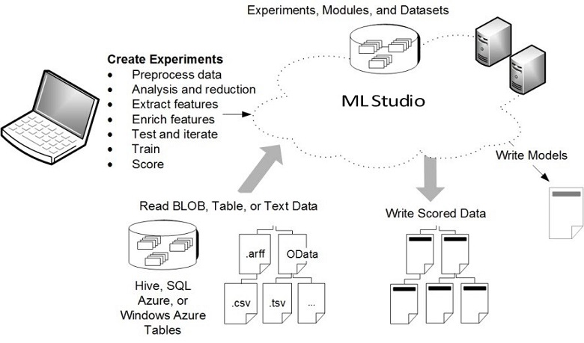
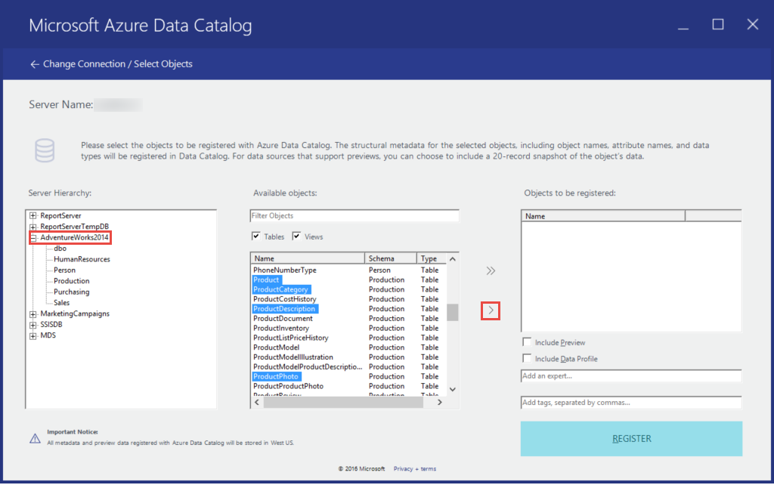
The Data Science/DevOps Difference – Accounts and Plumbing
“Code-less Coding” Examples
Notes:
Overview, capabilities, and use - https://docs.microsoft.com/en-us/azure/machine-learning/machine-learning-what-is-ml-studio
Exporting the web service - https://docs.microsoft.com/en-us/powershell/module/azurerm.machinelearning/?view=azurermps-1.7.0
PowerShell for exporting - https://github.com/hning86/azuremlps

Slide 33
Lab:
Exporting an Azure ML Experiment
Notes:
Create an Azure ML Experiment – Follow the examples here: https://github.com/Azure-Readiness/hol-azure-machine-learning
Export the experiment: https://docs.microsoft.com/en-us/powershell/module/azurerm.machinelearning/?view=azurermps-1.7.0

Slide 34
The Data Science/DevOps Difference
Data Flow
Business Understanding
Define Objectives
Identify Data Sources
Data Acquisition and Understanding
Ingest Data
Explore Data
Modeling
Feature Selection
Create and Train Model
Deployment
Customer Acceptance
Operationalize
Testing and Validation
Update Data
Handoff
Re-train and re-score
Notes:
Without a good data flow design, your project may not go into production - https://medium.com/towards-data-science/how-to-build-a-data-science-pipeline-f24341848045

Slide 35
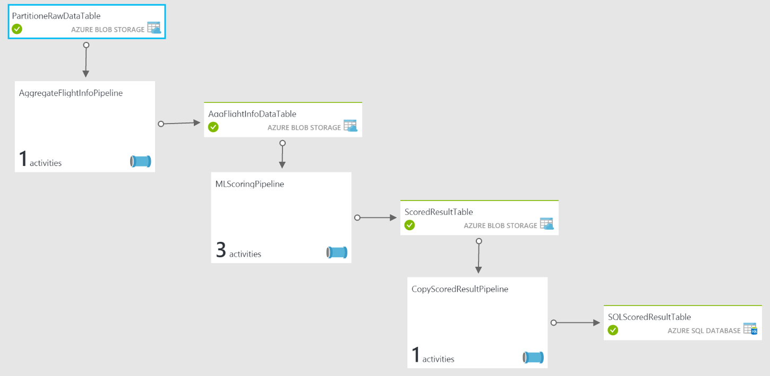
The Data Science/DevOps Difference – Data Flow
Azure Data Factory
Notes:
Understanding an ADF Pipeline with an example - https://docs.microsoft.com/en-us/azure/data-factory/data-factory-create-pipelines

Slide 36
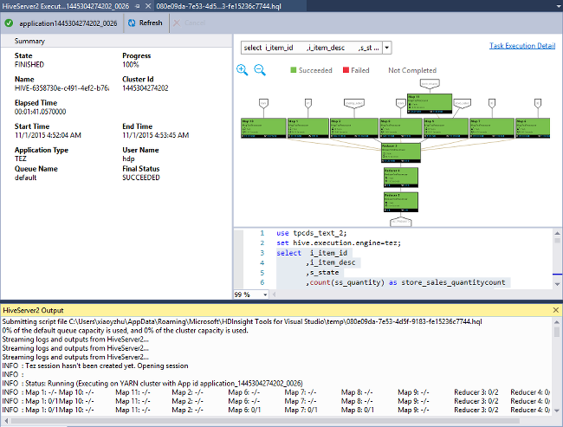
The Data Science/DevOps Difference – Data Flow
Visual Studio with Azure Tools
Notes:
Azure HDInsight Tools for Visual Studio - https://docs.microsoft.com/en-us/azure/hdinsight/hdinsight-hadoop-visual-studio-tools-get-started
Azure Data Lake Tools for Visual Studio - https://docs.microsoft.com/en-us/azure/data-lake-analytics/data-lake-analytics-data-lake-tools-get-started

Slide 37
The Data Science/DevOps Difference
Build and Test
Business Understanding
Define Objectives
Identify Data Sources
Data Acquisition and Understanding
Ingest Data
Explore Data
Modeling
Feature Selection
Create and Train Model
Deployment
Customer Acceptance
Operationalize
Testing and Validation
Update Data
Handoff
Re-train and re-score
Notes:
Assets within a Data Science project may contain multiple artifacts. For the most part, an Azure Resource Manager template can contain most of these - https://docs.microsoft.com/en-us/azure/azure-resource-manager/resource-group-template-deploy-portal

Slide 38
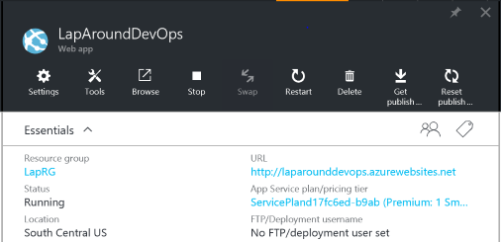
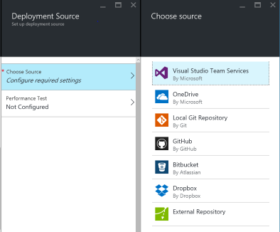
The Data Science/DevOps Difference – Build and Test
The Microsoft Azure Portal
Notes:
Main Portal Documentation - https://docs.microsoft.com/en-us/azure/azure-portal-overview
DevOps with the Azure Portal - https://docs.microsoft.com/en-us/azure/azure-portal/tutorial-azureportal-devops

Slide 39
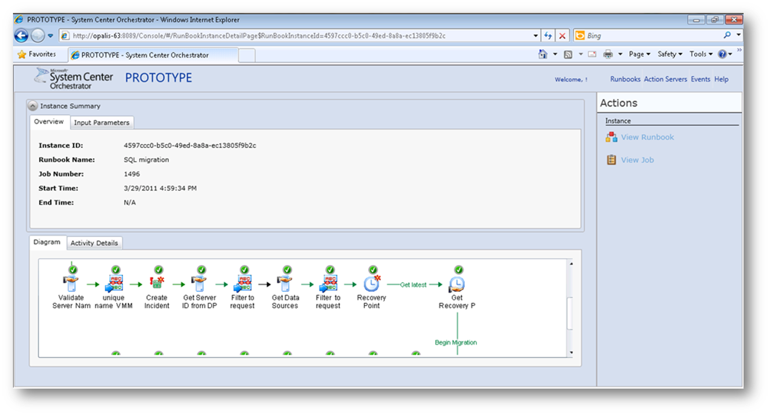
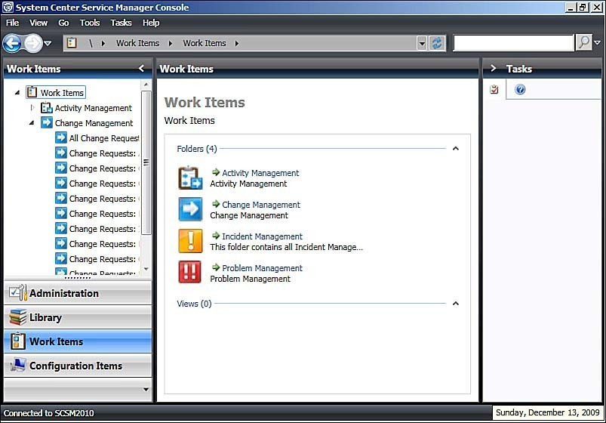
The Data Science/DevOps Difference – Build and Test
System Center
Notes:
Using System Center Runbooks - https://technet.microsoft.com/en-us/library/hh403791(v=sc.12).aspx

Slide 40
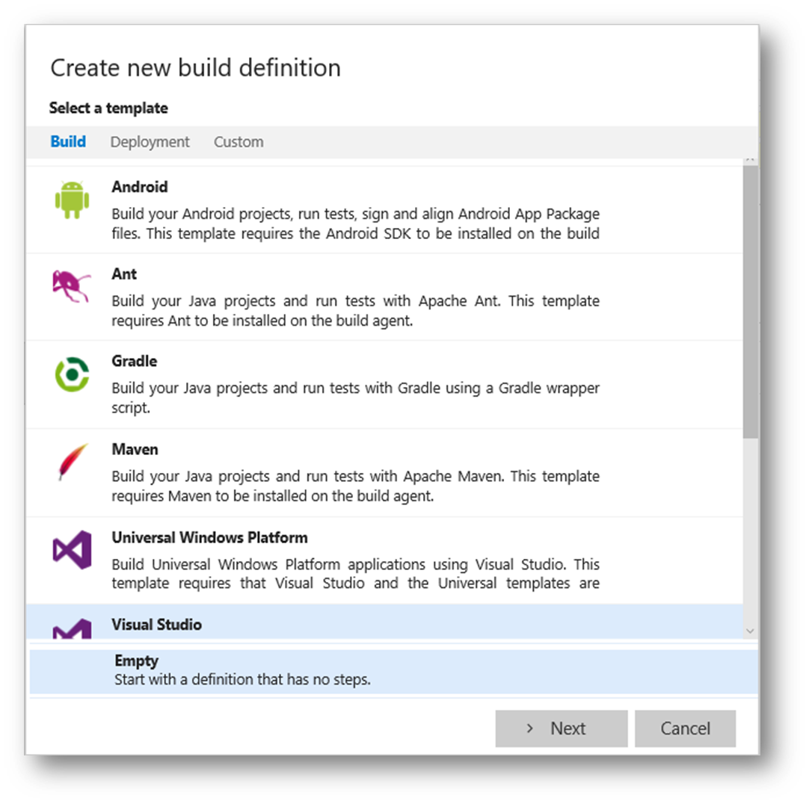
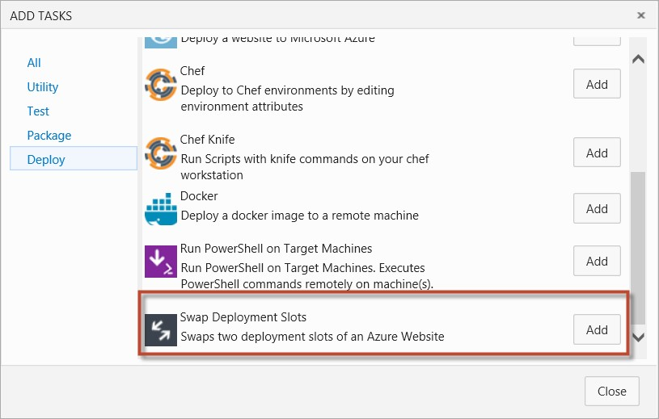
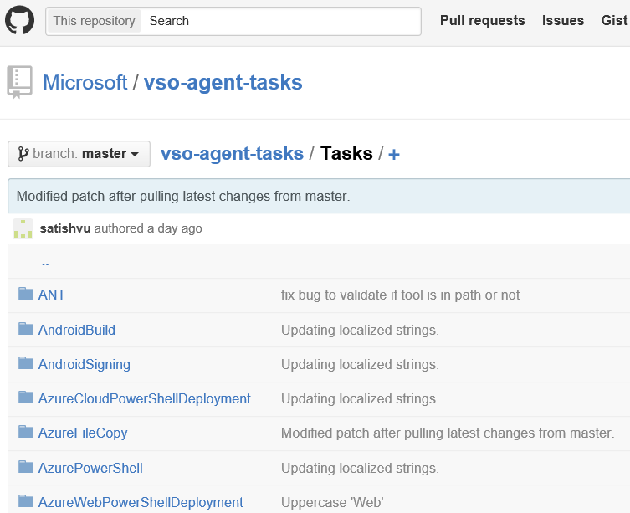
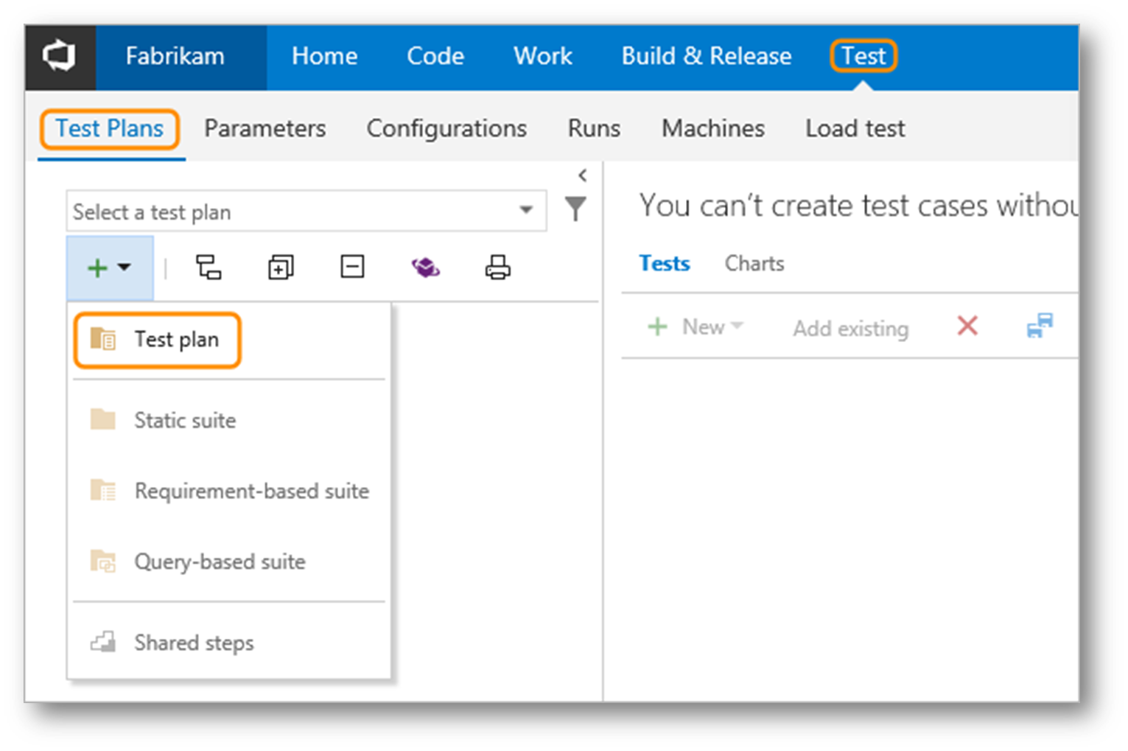
Custom Build Tasks
The Data Science/DevOps Difference – Build and Test
Visual Studio with VSTS / TFS
Notes:
Understanding TFS/VSO builds - https://msdn.microsoft.com/en-us/library/ms181709(v=vs.90).aspx
Integrating with Service Hooks - https://www.visualstudio.com/get-started/integrate/integrating-with-service-hooks-vs

Slide 41
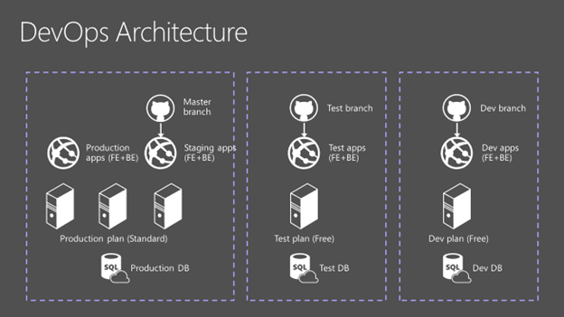
The Data Science/DevOps Difference – Build and Test
Azure Deployment Service – working with git
Notes:
Main reference - https://docs.microsoft.com/en-us/azure/app-service/app-service-deployment-readme
Reference architecture - https://docs.microsoft.com/en-us/azure/app-service-web/app-service-agile-software-development

Slide 42
Lab:
Create a CI / CD Process
Notes:
In this lab you will learn how to create a Continuous Integration (CI) Process for a solution, which can include a Machine Learning, Cognitive Services, or Artificial Intelligence application.
There are three labs here, depending on the technology you will use. The instructor will select one scenario for this class, but you can work through the others on your own time.
Scenario 1 - VSTS lab (Azure and Visual Studio needed)
Go to https://app.vsaex.visualstudio.com/me?mkt=en-US#, log in with your Microsoft credentials (must be tied to your Azure account for this lab)
Select "Create new account"
Determine a name to host your projects at. Select "Manage code using Git", and select "Continue"
Complete https://docs.microsoft.com/en-us/vsts/build-release/apps/cd/azure/aspnet-core-to-azure-webapp?tabs=vsts#tabpanel_MIwoaKejp9_vsts (Steps 1-4 ~15min)
Complete https://docs.microsoft.com/en-us/vsts/build-release/actions/ci-build-git (~15-20min)
Scenario 2 - VSTS lab and GitHub (no Azure needed)
Go to GitHub and fork this repo https://github.com/adventworks/dotnetcore-sample (create a GitHub account if you don't have one).
In an InPrivate browser, log in to https://go.microsoft.com/fwlink/?LinkId=307137 with a Microsoft account (outlook, live, hotmail, etc.)
Select "Create new account"
Determine a name to host your projects at. Select "Manage code using Git", and select "Continue", and create a new project.
Follow the instructions here to create a Continuous Integration build process for your GitHub repo https://docs.microsoft.com/en-us/vsts/build-release/actions/ci-build-github
CI/CD GitHub lab (no VSTS or Azure needed)
Create a GitHub repo
Log in to GitHub (or create an account if you don't have one)
Select the "+" button in the top right corner, then "New repository"
Name the repo and check the box "Initialize this repository with a README
Create the repo.
Select "Create new file" and title it "default.html"
Paste in the following code
<!DOCTYPE html>
<html lang="en" xmlns="http://www.w3.org/1999/xhtml">
<head>
<meta charset="utf-8" />
<title></title>
<style type="text/css">
body { font-family: "Segoe UI Light"}
</style>
</head>
<body>
<h1>Hello World</h1>
<p>Welcome to the CD of your Azure Web App from GitHub.</p>
</body>
</html>
Commit the file (at the bottom of the new file page)
Log into the Azure portal and deploy a Web App.
Follow the steps here https://docs.microsoft.com/en-us/azure/app-service/app-service-continuous-deployment using your GitHub as the deployment source
Make a change to your html file (maybe change or add some text?) via GitHub, commit the change. Was it reflected in your web app?

Slide 43
The Data Science/DevOps Difference
Security
Business Understanding
Define Objectives
Identify Data Sources
Data Acquisition and Understanding
Ingest Data
Explore Data
Modeling
Feature Selection
Create and Train Model
Deployment
Customer Acceptance
Operationalize
Testing and Validation
Update Data
Handoff
Re-train and re-score
Notes:
The Azure Trust Center (Security, Privacy, Transparency, Compliance) - https://azure.microsoft.com/en-us/support/trust-center/
Working with the Azure Key Vault - https://blogs.msdn.microsoft.com/troy_aults_blog/2017/08/29/utilizing-key-vault-to-create-credentials-for-automation/

Slide 44
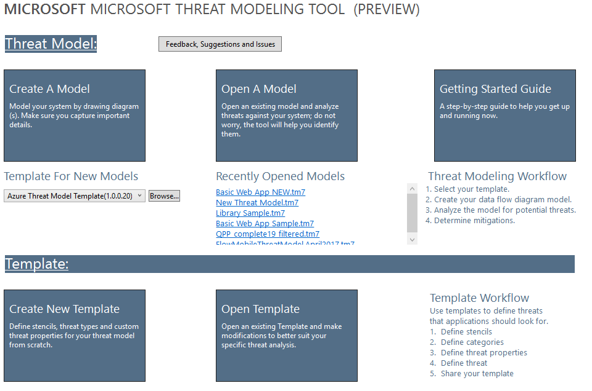
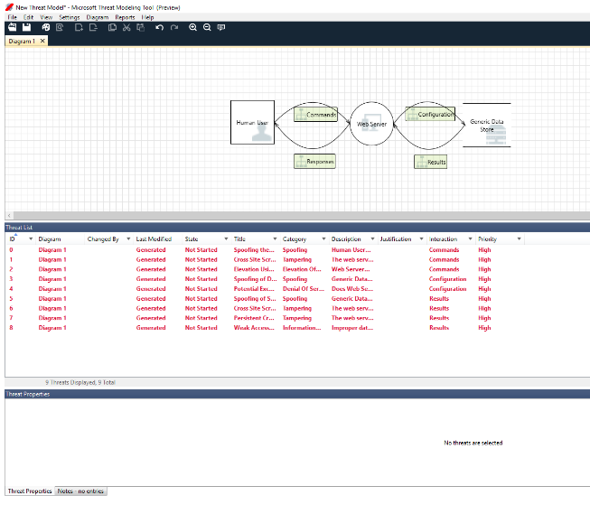
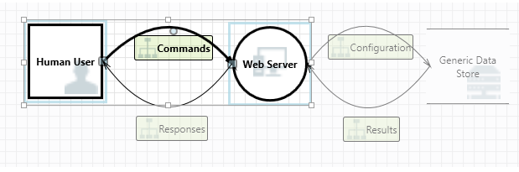
The Data Science/DevOps Difference – Security
The Microsoft Threat Modeling Tool
Notes:
Uses the STRIDE methodology - (Spoofing, Tampering, Info Disclosure, Denial of Service and Elevation of Privilege) - https://en.wikipedia.org/wiki/STRIDE_(security)
The Threat Modeling Tool and the SDL - https://docs.microsoft.com/en-us/azure/security/azure-security-threat-modeling-tool
The Microsoft Threat Modeling Tool download - https://www.microsoft.com/en-us/download/details.aspx?id=49168

Slide 45
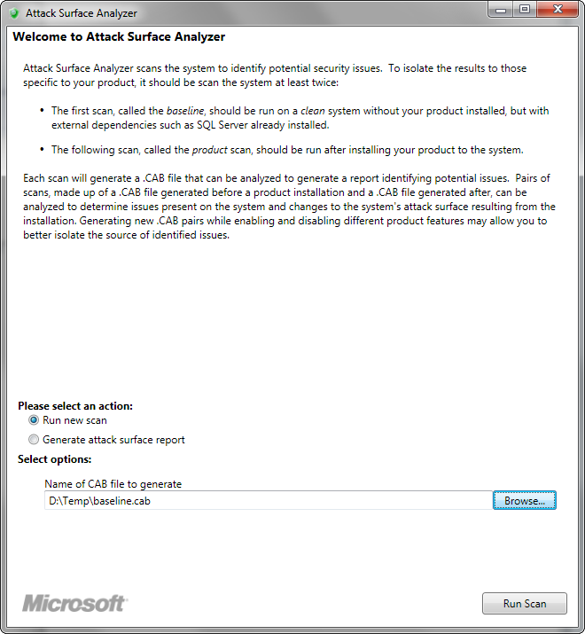
The Data Science/DevOps Difference – Security
The Microsoft Attack Surface Analyzer
Notes:
This tool helps to ensure you keep Windows secure, checking your app to make sure it does not introduce new vulnerabilities - https://technet.microsoft.com/en-us/security/gg749821.aspx

Slide 46
Lab:
Create a Threat Model using the Microsoft Threat Analyzer
Notes:
Download and install the Microsoft Threat Analyzer tool
Create a simple web app flow
View the analysis pane
Create a web report of your application

Slide 47
Other Considerations
Business Understanding
Define Objectives
Identify Data Sources
Data Acquisition and Understanding
Ingest Data
Explore Data
Modeling
Feature Selection
Create and Train Model
Deployment
Customer Acceptance
Operationalize
Testing and Validation
Update Data
Handoff
Re-train and re-score
Notes:
There is a great deal more information and many other tools to learn – all depend on your implementation

Slide 48
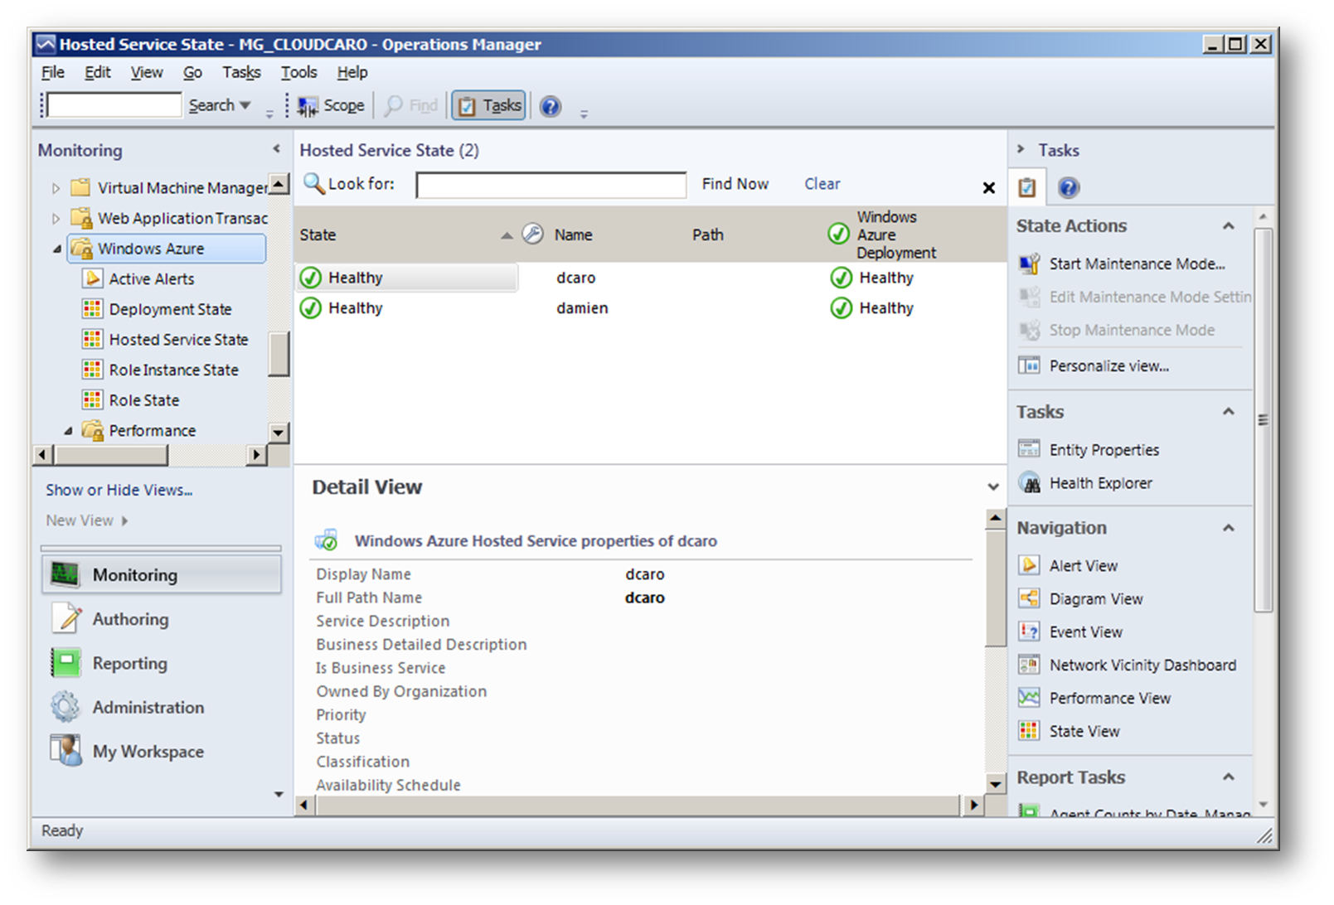
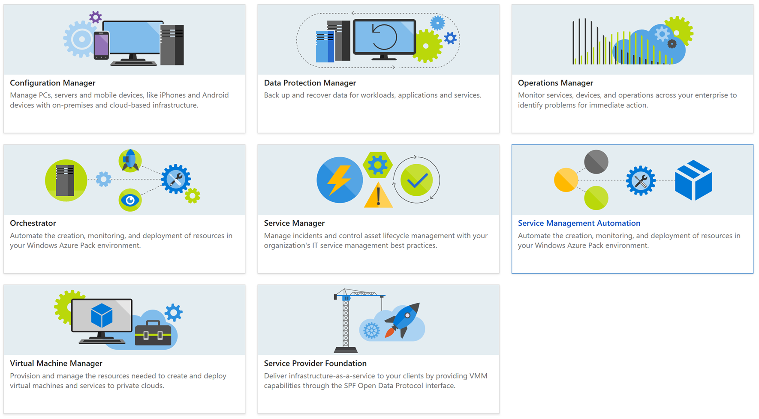
The Data Science/DevOps Difference – Other
Monitoring – with System Center
Notes:
Many organizations have implemented System Center. This system can be integrated with “Packs” - https://docs.microsoft.com/en-us/system-center/orchestrator/windows-azure-integration-pack

Slide 49
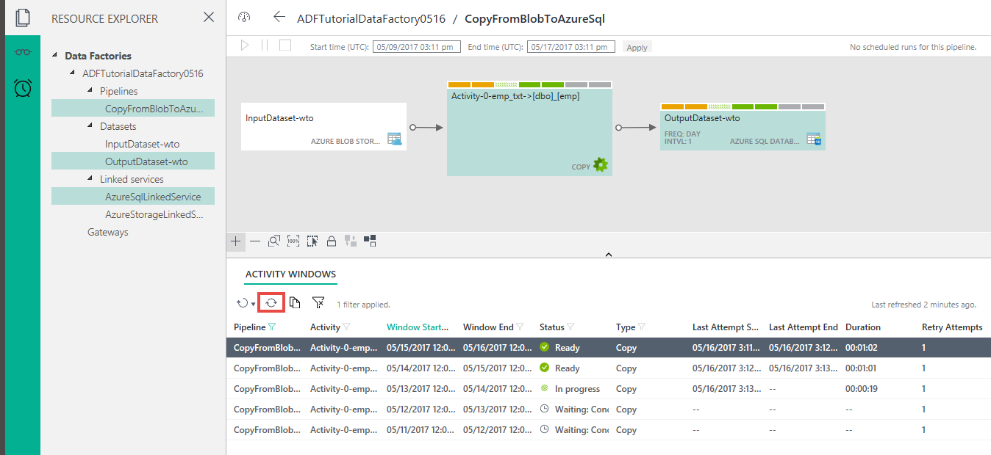
The Data Science/DevOps Difference – Other
Monitoring with Azure Data Factory
Notes:
There is also a full app for monitoring ADF along with the Azure Portal - https://docs.microsoft.com/en-us/azure/data-factory/data-factory-monitor-manage-app

Slide 50

The Data Science/DevOps Difference – Other
Monitoring with Application Insights
Application Insights
Notes:
Overview: https://docs.microsoft.com/en-us/azure/application-insights/app-insights-overview

Slide 51
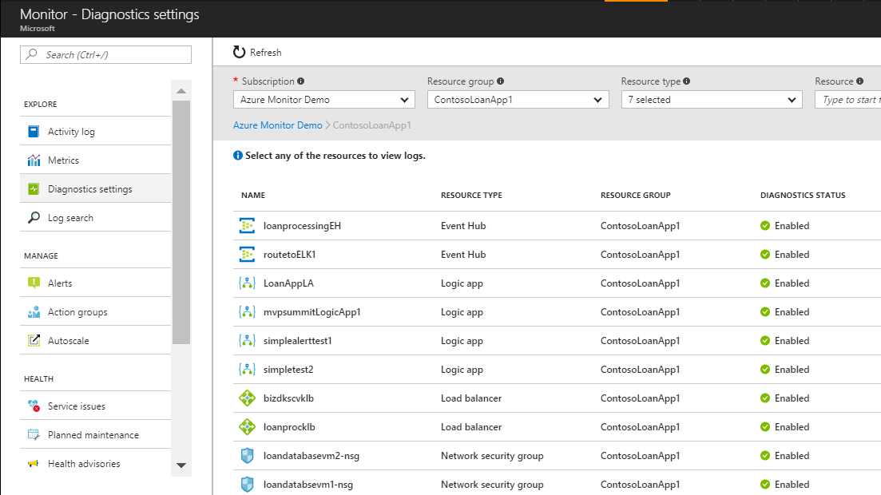
The Data Science/DevOps Difference – Other
Swiss-Army Knife - Log Scrubbing
Notes:
Using Azure Monitor - https://azure.microsoft.com/en-us/blog/azure-monitor-multiple-diagnostic-settings/
The Azure Log Analytics - https://channel9.msdn.com/Shows/Azure-Friday/Azure-Log-Analytics

Slide 52
Lab:
Monitoring by querying Azure Logs
Notes:
Open this link: https://portal.loganalytics.io/demo#/discover/home
Run the “Data Types” query in the main panel.
Add a single table to add it to your query.
Filter the results.
Change the view to table from Pie Chart
Export all columns to Excel

Slide 53
Resources for DevOps Practices
Optimize your DevOps practices and tools:
Get started on your DevOps journey: aka.ms/devops
Download the Forrester Infrastructure-as-Code whitepaper:
Complexity kills. Automate with Infra as code: aka.ms/iac_tlp
Technical resources for Practitioners:
Get access to free online training, evals and HOLs: aka.ms/devopsmva
Watch DevOps episodes of the Edge Show
Get current DevOps news and technical demos from engineering: http://aka.ms/edgedevops
Join the Community conversations:
Use #TalkDevOps on Twitter

Slide 54

BuckWoody.Wordpress.Com

